Slide 1
Pipettes Trade-In Program ULS – Europe Launch Training
Vincent Lombard
January 24th & 25th 2017

Slide 2
Scope & Goal
Over 15 000 pipettes from any brand are serviced by ULS in Europe yearly
Some of those pipettes must be repaired but are beyond economical repair
Make sure a new pipette is sold by Thermo Fisher Scientific when the repair is not profitable to the end user
Leads to be shared by ULS engineers to local LPG sales via the Ulead webpage
Provide a streamlined and harmonized process in Europe for this purpose
Ultimately better serve our customers for CAS and Revenue improvement

Slide 3
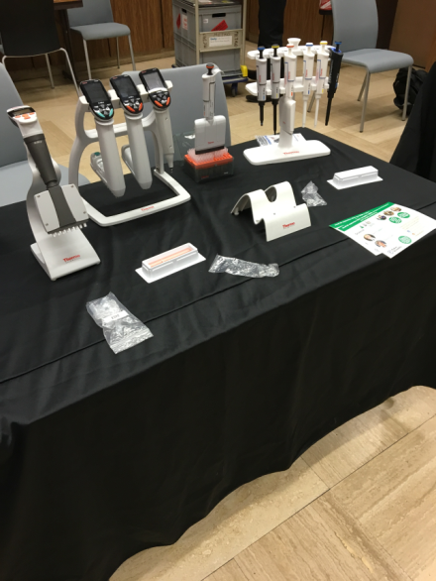
Process 1 / 2
If the repair price to be invoiced to the end user is above:
Manual pipettes
Single channel >100€
Multichannel >200€
Electronic pipettes
Single channel >200€
Multichannel >300€
ULS Engineer contact the end user to get approval from customer to propose a new pipette
ULS Engineer fills the « pipette » dedicated form on the Ulead web page

Slide 4
Process 1 / 2
Lead are routed to respective LPG Sales person according to standard lead routing process
LPG Sales person to contact the end user by phone within 24h to qualify the lead and propose a new pipette using the Trade-In programs (ClipTip family, Finnpipette F1 and F2)
Sales to follow-up with the customer within 1 week
Sales to inform the ULS lead submitter via email
if customer accepted the Trade-in offer OR
if customer wants the pipette to be repaired

Slide 5
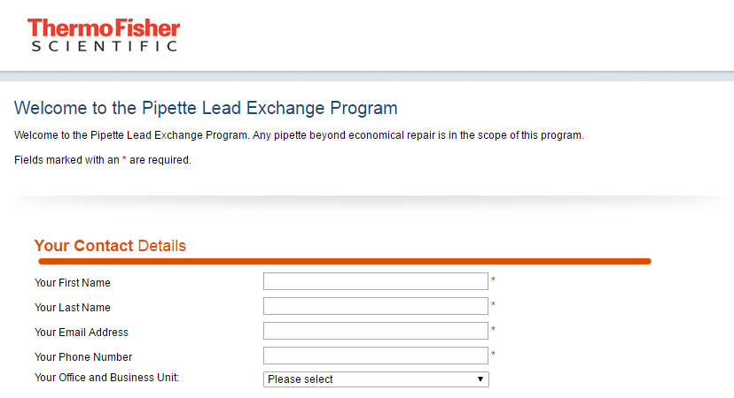
Ulead WebForm 1/3
To submit a lead go to www.unitylabservices.com/ulead
Select « Pipette / replacement of a pipette beyond economical repair»

Slide 6
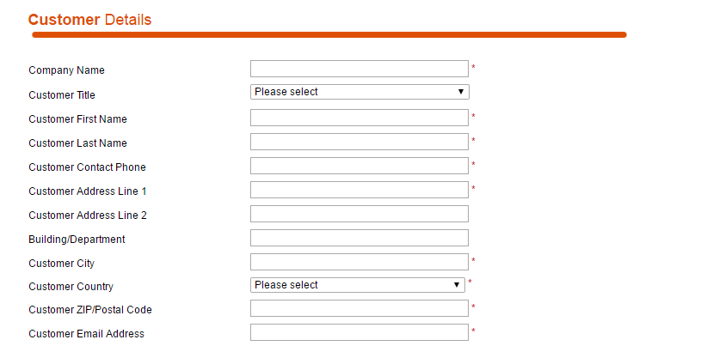
Ulead WebForm 2/3

Slide 7
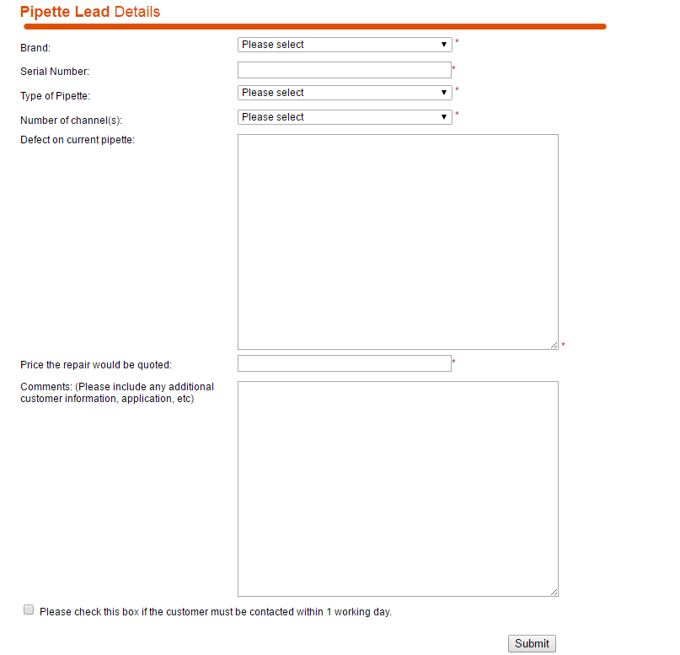
Ulead WebForm 3/3

Slide 8
What is expected from you
ULS Engineer
Fill this new form for any pipette beyond economical repair upon approval from end user
Have the case on hold expecting a feedback from LPG Sales
Close the case (repair or trash or send back as is) when information form LPG Sales is communicated
Note that this program does not reward leads submissions with a commission
LPG Sales
Follow guidelines regarding timelines
Sale / Quote pipettes preferably with the Trade-In promotion
ALL
Report any issue regarding the process to:
vincent.lombard@thermofisher.com
+33 (0)6 72 75 47 42

Slide 9
BACK-UP

Slide 10
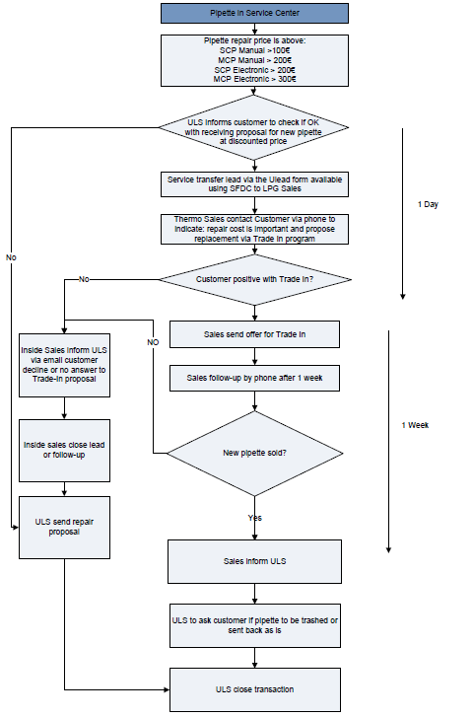
Back-up – detailed process flow

